Slide 1
Pizza Sales Analysis

Slide 2
INTRODUCTON
I’m Anshdeep Singh Rajput and this presentation
delves into a comprehensive analysis of pizza sales data utilizing SQL queries.
We will explore sales trends, identifying peak periods and popular menu items.
By leveraging SQL’s capabilities, we will uncover valuable
insights into customer behavior and ordering patterns.
This data-driven approach aims to provide actionable
recommendations to enhance sales strategies and
customer satisfaction.

Slide 3
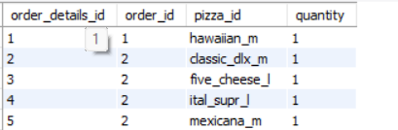
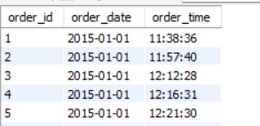
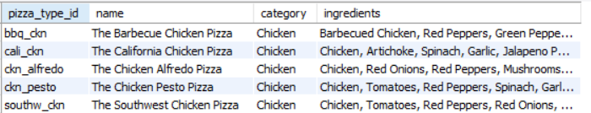
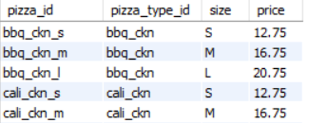
In this project, four data tables are used.
1. Order details
2. Orders
3. Pizza types
4. Pizzas

Slide 4
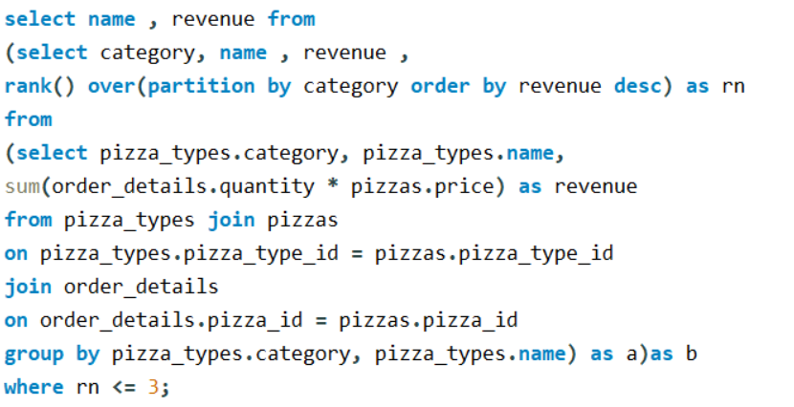
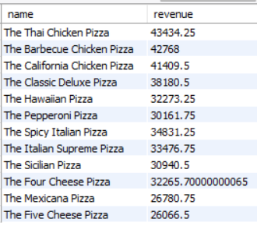
Determine the top 3 most ordered pizza types based on revenue for each pizza category.

Slide 5
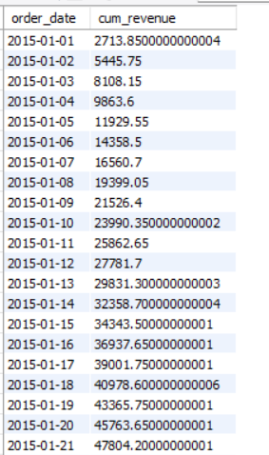
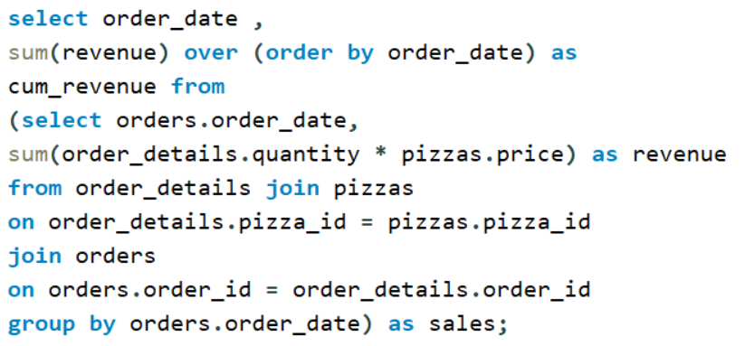
Analyze the cumulative revenue generated over time.

Slide 6
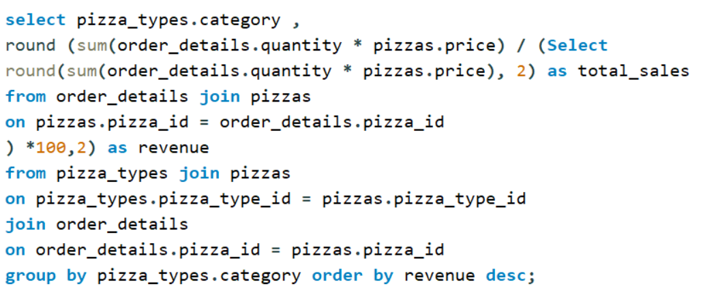
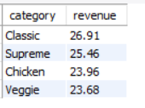
Calculate the percentage contribution of each pizza type to total revenue.

Slide 7
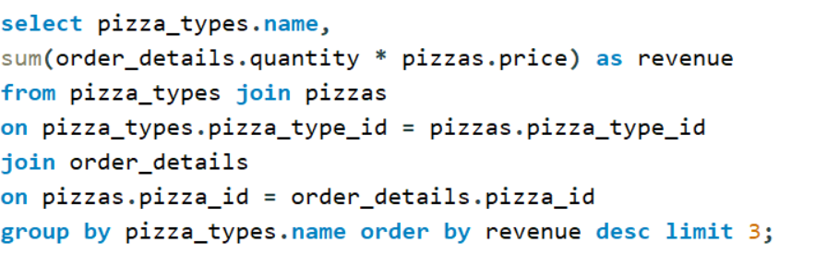
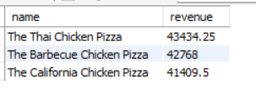
Determine the top 3 most ordered pizza types based on revenue.

Slide 8
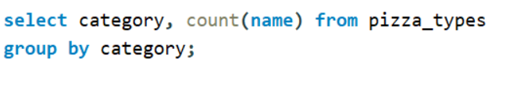
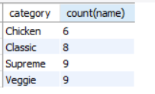
Join relevant tables to find the category-wise distribution of pizzas.

Slide 9
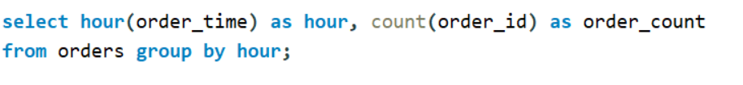
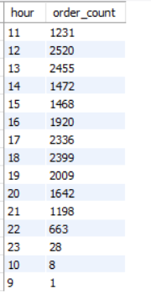
Determine the distribution of orders by hour of the day.

Slide 10
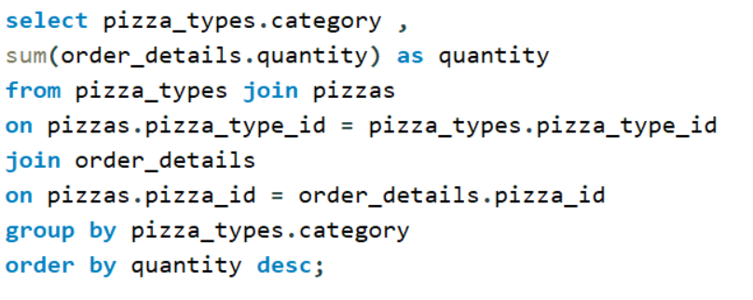
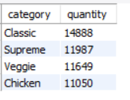
Join the necessary tables to find the total quantity of each pizza category ordered.

Slide 11
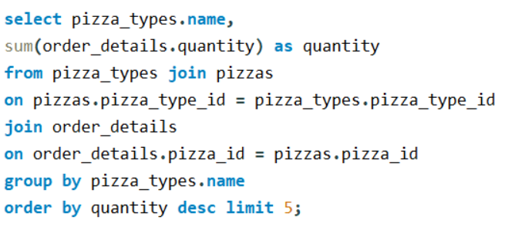
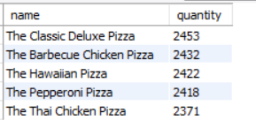
List the top 5 most ordered pizza types along with their quantities.

Slide 12
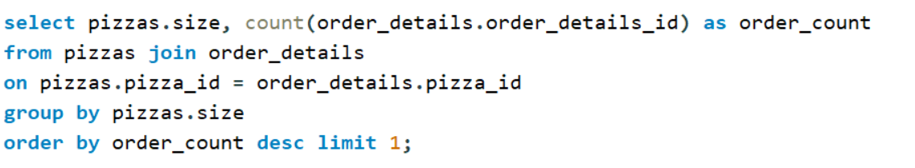
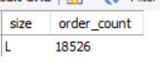
Identify the most common pizza size ordered.

Slide 13
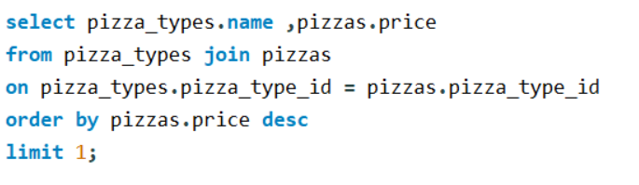
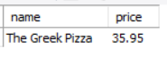
Identify the highest-priced pizza.

Slide 14
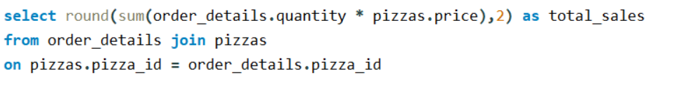
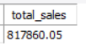
Calculate the total revenue generated from pizza sales.

Slide 15

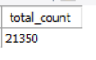
Retrieve the total number of orders placed.

Slide 16
INSIGHTS
Sales Performance:
1. Total Orders: This indicates overall customer demand.
2. Total Revenue: Provides a measure of overall sales performance.
Menu Analysis:
3. Highest-Priced Pizza: Helps identify high-profit margin items.
4. Most Common Size: Indicates customer preference for portion size.
5. Total Quantity by Category: Shows customer preference for different pizza styles (e.g., vegetarian, meat-lovers).

Slide 17
INSIGHTS
Order Patterns:
6. Distribution by Hour: Identifies peak ordering times for optimal staffing and marketing.
7. Category-wise Distribution: Shows how category preferences vary by order time
8. Average Pizzas per Day: Indicates daily sales trends and potential for promotions.
Revenue Breakdown:
9. Top 3 Pizzas by Revenue: Highlights the most profitable pizzas.
10. Revenue Contribution by Pizza Type: Shows the relative importance of each pizza to total sales.

Slide 18
THANK YOU

